Slide 1
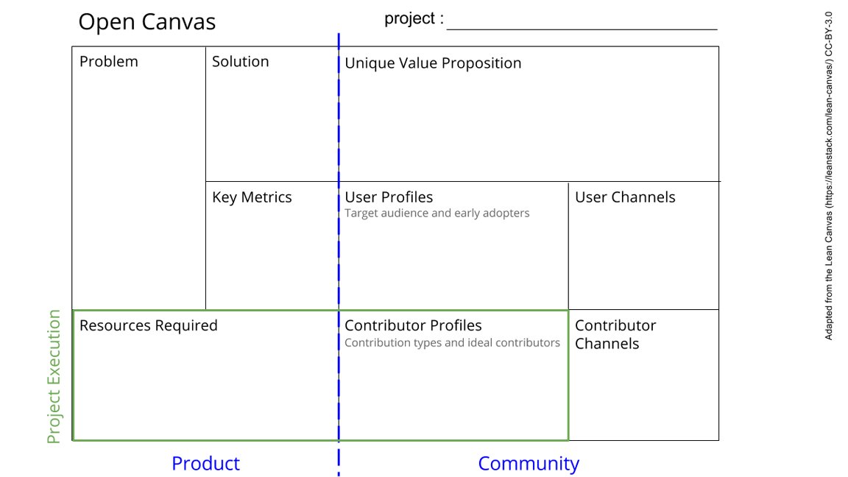
Strengthening Digital Research Infrastructure: Advancing Equitable Access for Racialized Researchers
•Poor awareness about DRA DRI resources among racialized researchers at THP
•Poor access to DRA DRI resources by racialized researchers at THP
•Awareness campaigns
•Training on DRI resources
•A unique capacity-building platform where equity-seeking groups and other researchers can learn more about DRI resources and how to access them.
An accessible institutional training resource for new staff.
•Number of awareness emails & newsletters shared
•Number of training topics delivered
•Number of researchers trained
•Emails
•Social media - LinkedIn
•Racialized scientists, research associates, graduate and undergraduate researchers
Other researchers at THP
Other interested staff
Human – communications/media expertise, DRI training expertise
Technology – laptop, audiovisuals, internet access
FinancialI – money
Materials – venue, stationery, refreshments
•Library staff, Communications team, My supervisors (academic & EDIA mentor), Other researchers, Other DRI/OLS trainees
•Emails
•Zoom meetings

